Slide 1
LOCSU Overview
ELC LOC AGM Presentation 2025
info@locsu.co.uk

Slide 2


Who are LOCSU?
LOCSU supports LOCs in England across a range of activities relating to primary eye care, including:
  Policy work and influencing
  Commissioning support
  Governance and compliance
  Training and development support
  Develop clinical pathways
Develop local case studies
What does LOCSU do for you?
Provide training and support to LOCs
LOC payroll service​
Produce webinars, podcasts and other accessible learning and information opportunities​
LOC model constitution engagement and update​
NOC25
Visit our website to find out more about LOCSU

Slide 3
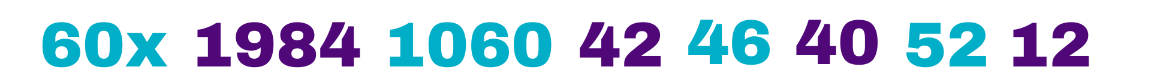

2023/25: LOCSU support to LOCs
£ increase in direct investment in LOCs, compared to the previous year
meetings to support LOC work
(average based on previous meetings attended)
CPD points issued, after expanded training offer
documents developed to support LOCs
LOCs utilising LocumKit, a LOCSU funded payroll service
LOCs have a live LOC-online website, with a further three in development
tools and support information for sharing with and influencing commissioners
accessible training and development courses for LOCs
You asked, we did
National Forum
Strengthening links and holding LOCSU to account.
Improved Communications
Improved communications, newsletters, bulletins and podcasts.
LOC Promotion
Promotion of LOCs at universities and 100% Optical (132 visitors and a third signposted to LOCs).
Plus
Standard Specification
National standard specification for CUES (community minor and urgent care) following a ministerial request.
Constitution Development
Developed with legal advice.
National conduit
OFNC and sector bodies.
Advocacy
Partnership and advocacy around Marsha De Cordova bill. All-Party Parliamentary groups, Five nations and roundtables.
NOC
Largest and most ambitious to date!
Scan to read the LOCSU Annual Report
Chair Conference/ Comms forum
Expanding the networking offer and role focused forums.

Slide 4
National Hot Topics for 2025/26
Digital
SPoA/Referral Management & patient choice
Digital connectivity
Clinical
CVD prevention in Optometry
Sight testing in Special Schools
Glaucoma Care

Slide 5

Our Activity
NOC 2025
  18 and 19 May 2025, Birmingham Hilton Metropole
New LOC model constitution
  Launch final draft in April, support LOCs to adopt
  Develop supporting policies and tools
LOCSU strategy
A new three-year strategy, has been publishes, focusing on what we deliver for LOCs
Levy reduction
Focus on enhanced services
Pathway review and refresh
Building the evidence base
Picture: Regional Optical Conference, Nov. 2024 - coproduction of new model constitution with LOCs

Slide 6
LOC constitution
What is the model constitution?
LOCs each have a constitution that describes how they operate
The Model Constitution is a template maintained by LOCSU
The Model Constitution is legally drafted to ensure it supports good governance and aligns with the NHS Act
LOC has circulated the updated constitution with the pack for this AGM.

Slide 7
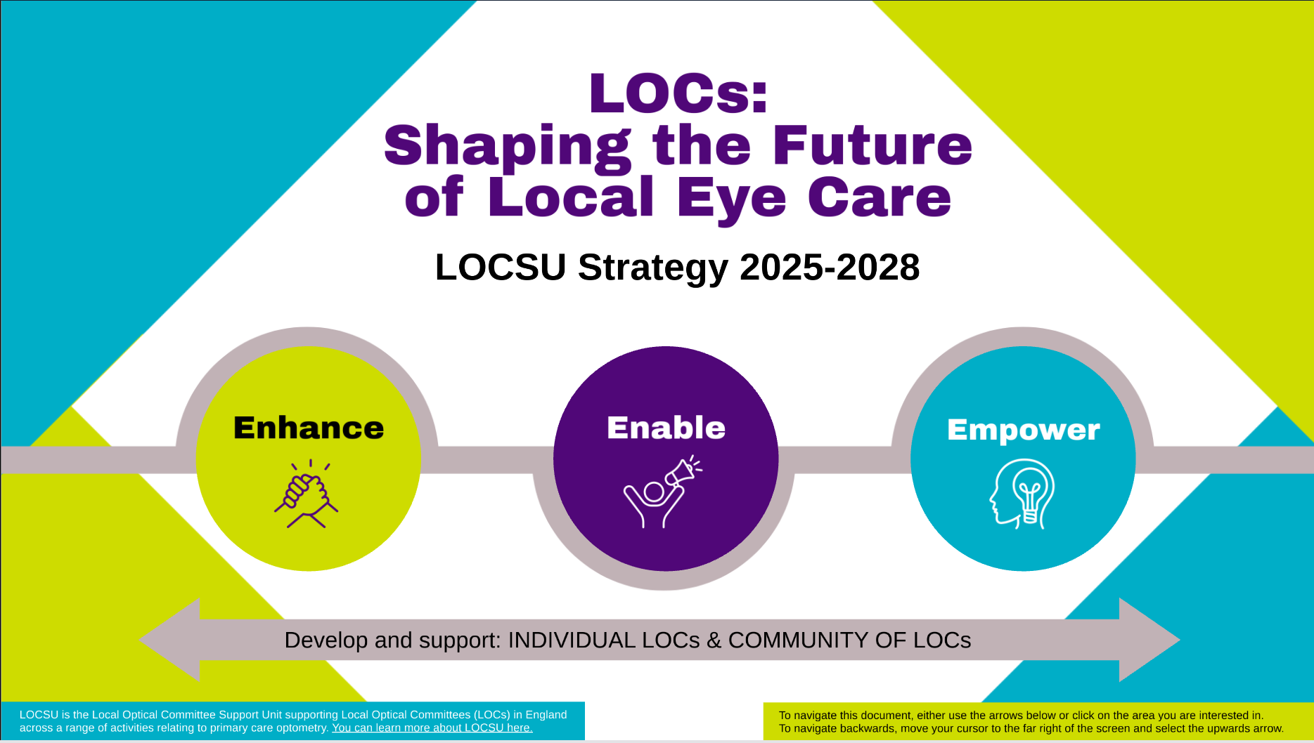
LOCSU Board
Strategy 2025 - 2028
& Business Plan 2025-2026
20 March 2025
Notes:
Whole image is a link to Prezi!

Slide 8
LOCSU’s 3 Pledges
ENHANCE LOC OPERATIONS
Provide support and services to optimise efficient committees and develop LOC leaders of the future.
ENABLE
LOC INFLUENCE
Provide subject matter expertise, evidence driven clinical pathways, and resources & guidance with a tailored LOC focus to support discussions with local decision makers.
EMPOWER
LOC STRATEGY DEVELOPMENT
Provide opportunities to horizon scan and influence national discussions with an accessible central knowledge hub to inform discussions.
Develop and support: INDIVIDUAL LOCs & COMMUNITY OF LOCs

Slide 9
Pledges to pillars
ENHANCE
operational
efficiency and succession planning
Reduce LOC operational costs and duplication through reaping economies of scale.
Promote LOCs and develop the skills of the next generation of LOC talent.
Support strong local leaders with robust governance.
ENABLE
influencing with national resources and guidance
Provide tailored LOC resources to enhance influencing of ICBs to sustain and grow primary care optometry.
Facilitate knowledge sharing and maximise subject matter expertise.
Provide 1:1 LOC support and assist LOCs local discussions as an extension of LOCs.
Maintain national resources such as QiO.
EMPOWER strategic success
with a central knowledge hub
Facilitate space to collaborate and prepare fit for the future primary care optometry, aligned locally, regionally & nationally.
Consolidate data & evidence with a single accessible hub.
Showcase innovation to influence decision makers and expand services delivered through local contractors.
Develop and support: INDIVIDUAL LOCs & COMMUNITY OF LOCs

Slide 10
Pillars to action – strategy of support
LOCs & LOC COMMUNITY
ENHANCE
LOC Operations
(how)
ENABLE
LOC Influence (now)
EMPOWER
LOC Strategy Development
(future)
Training and development
Toolkits & cross fertilisation/sharing & networking
Operational support & governance &
at-scale services
National resources
Clinical/ enhanced services
Central national knowledge hub

Slide 11
Tangible support to LOCs
LOCs & LOC COMMUNITY
ENHANCE
LOC Operations
(how)
ENABLE
LOC Influence (now)
EMPOWER
LOC Strategy Development
(future)
Training and Development
CPD
Succession planning support
Committee/leadership skills
LOC induction, interim & leadership courses
Toolkits & networking
Ready to use templates & toolkits
National, regional & role forums
Promotion of LOCs
Constituent engagement support
NOC/ROC & role specific events
Regular strategic updates (inc. bulletins)
Operational Support
PCSE/NHSE
Payroll
Constitution & governance
Digital – inc. tech solutions & LOC online
Document templates
National resources
Library of national digest documents
QiO
Influence national discussions on current opportunities & challenges
Case studies
Central hub data/knowledge tailored to LOCs
Eye to the future
Local, regional & national LOC strategies
Collation & curation of national knowledge through 1 accessible platform
Promotion of primary eye care
Influence national discussions on future opportunities & challenges
Strategic LOC forum
Clinical/enhanced services
Service specifications & pathways (inc. promotion)
Supporting cases & data
WOPEC accreditations/delivery standards
Bids for national projects/pilots (CVD)
PEC relations/support

Slide 12


